Slide 1
Changing the Conversation:
Taking Trauma Into Account When Representing Children
in Foster Care
-Kristen Bell, JD, M.Ed
Texas Lawyers for Children
©️
2019 Texas Lawyers for Children

Slide 2
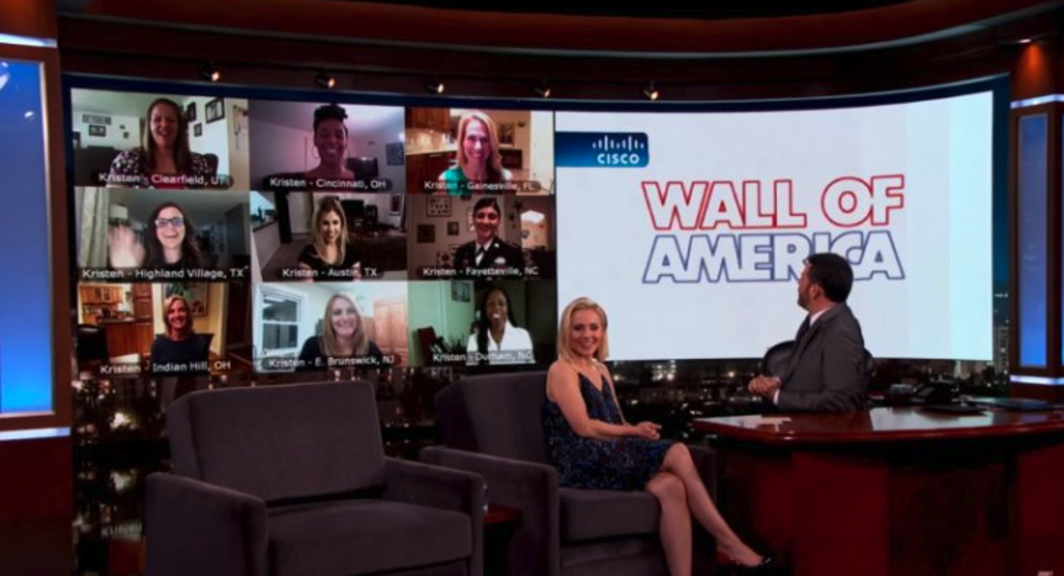

Slide 3
Why is child’s exposure to trauma, ACEs and toxic stress so important?
The child’s experience comes at a time of global cognitive, physical, psychological, behavioral, social, and emotional development.
These experiences that involve harm from the person who is supposed to care for them or that remove their trusted caregiver from the position of being their “safe place” – this relational trauma – shakes them to the core.
©️
2019 Texas Lawyers for Children

Slide 4
Because of childhood traumatic experiences, children can struggle --
to understand the world
to balance sensory input
to interpret whether a situation is safe or not
to determine if a person is safe or not
to read people’s cues, body language, facial expressions
to trust
to have “normal” physiological response to stress
to recover from stress
to focus on tasks beyond survival
to develop self-awareness
to learn
to see cause and effect of own actions and actions of others
to interact and connect with others
to understand the effect of rewards and punishment
to reflect on past experiences and learn from them
©️
2019 Texas Lawyers for Children

Slide 5
Trauma affects a child’s – (5 B’s – Dr. Purvis)
Brain
Biology
Body
Beliefs
Behaviors

Slide 6
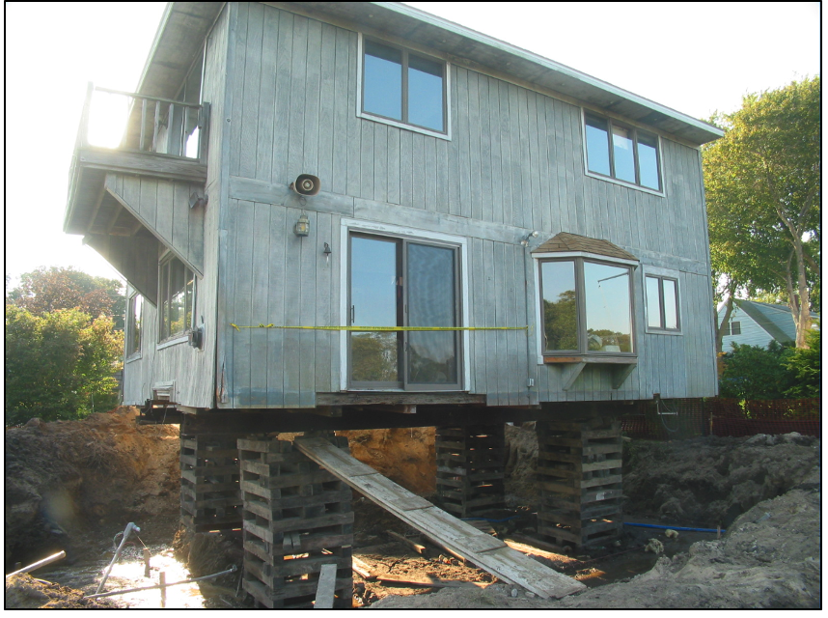

Slide 7
How Do We Misunderstand the Behaviors of Children Who Have Suffered the Trauma of Abuse and Neglect?

Slide 8
DOWNWARD SPIRAL OF HARM
©️
2019 Texas Lawyers for Children

Slide 9
DUTY To “Change the Conversation”: Texas Family Code 107.004
(d-3) An attorney ad litem appointed to represent a child in the managing conservatorship of the Department of Family Services shall periodically continue to review the child’s safety and well-being, including any effects of trauma to the child, and take appropriate action including requesting a review hearing when necessary to address an issue of concern.

Slide 10
©️
2019 Texas Lawyers for Children

Slide 11
When looking to help the child heal and to prevent further harm, we have to change the questions. Instead of seeing behavior as something to “Fix”, we need to see behavior as a – *CLUE *COMMUNICATION *COPING STRATEGY
©️
2019 Texas Lawyers for Children

Slide 13
©️
2019 Texas Lawyers for Children

Slide 14
What IF . . .

Slide 15
What Does This Child Need?
Connection
Prerequisite to Connection: Safety
Effect of Connection: Opportunity to Rewire
©️
2019 Texas Lawyers for Children

Slide 16
IMPORTANCE OF CONNECTION

Slide 17
We Reinforce What We Repeat.
©️
2019 Texas Lawyers for Children

Slide 18
“Change the Conversation”
In Informal Advocacy Efforts
In Interactions with Client
In Oral/Written Advocacy in Court
©️
2019 Texas Lawyers for Children

Slide 19
Changing the Conversation: Informal Advocacy
©️
2019 Texas Lawyers for Children

Slide 20
1. Is the child connected? Does the child feel safe?
©️
2019 Texas Lawyers for Children

Slide 21
2. Are we asking, “What happened to this child? What does this child need?”
©️
2019 Texas Lawyers for Children

Slide 22
3. Are we being PROACTIVE or REACTIVE? Do we have a plan to prevent and/or address behaviors?
©️
2019 Texas Lawyers for Children

Slide 23
4. Have we given the child any labels without taking his or her trauma into account?
©️
2019 Texas Lawyers for Children

Slide 24
5. If there is an incident, are we looking at what happened before the incident to see if anything triggered the child?
©️
2019 Texas Lawyers for Children

Slide 25
6A. If the child is being redirected or corrected, are we ensuring that healthy connections are maintained?
©️
2019 Texas Lawyers for Children

Slide 26
6B. Are we giving the child time – in a safe environment – to practice appropriate behaviors and responses?
©️
2019 Texas Lawyers for Children

Slide 27
7. If we take away a strategy a child has used to survive, are we replacing it with a healthy alternative?
©️
2019 Texas Lawyers for Children

Slide 28
8. Does the child have a voice?
©️
2019 Texas Lawyers for Children

Slide 29
9. Does the child need any additional tools to learn, connect with the world, connect with others?
©️
2019 Texas Lawyers for Children

Slide 30
10. Does the caregiver need any additional tools to connect with the child or help the child manage his or her emotions?
©️
2019 Texas Lawyers for Children

Slide 31
Remember . . .
Conflict and relapses are not inherently bad
They can be opportunities to teach and build trust
©️
2019 Texas Lawyers for Children

Slide 32
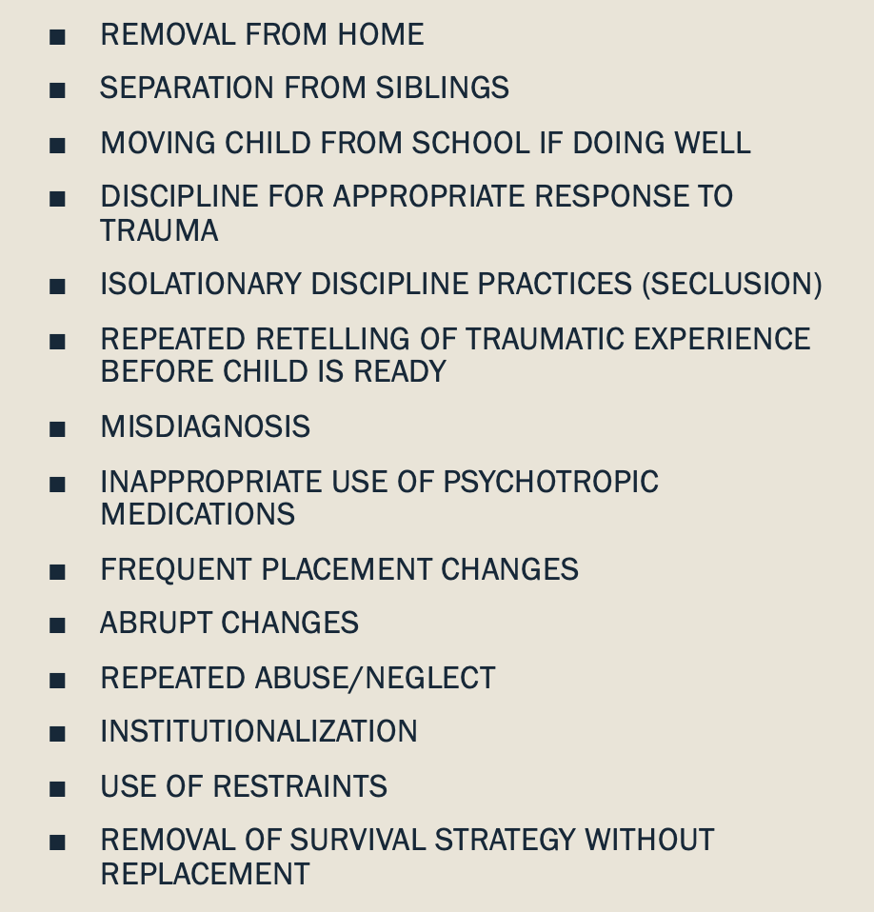
When we “change the conversation”, we minimize traumatizing practices and policies
©️
2019 Texas Lawyers for Children

