Slide 1
The Uniform Child Custody Jurisdiction and Enforcement Act (UCCJEA): A Primer
W. Drake Mikeska
Regional Attorney for DFPS
Region 8

Slide 2
Brief History
1968: Uniform Child Custody Jurisdiction Act (UCCJA)
Adopted by all 50 states by 1981
1981: Parental Kidnapping Prevention Act (PKPA)
Differences between the UCCJA and PKPA

Slide 3
Brief History
Uniform Child Custody Jurisdiction and Enforcement Act (UCCJEA)
Proposed by the Uniform Law Commissioners in 1997
Adopted by Texas Legislature in 1999 (effective Sept. 1, 1999)
Contained in Chapter 152 of the Texas Family Code
UCCJEA reconciles differences between the UCCJA and PKPA

Slide 4
What cases does the UCCJEA apply to?
Cases resulting in a “child custody determination”
TFC § 152.102(3) defines “child custody determination” as “a judgment, decree, or other order of a court providing for legal custody, physical custody, or visitation with respect to a child.”
The jurisdictional rules apply to all “child custody proceedings”
TFC § 152.102(4) defines a “child custody proceeding”
The definition includes cases involving abuse, neglect, and the termination of parental rights

Slide 5
Jurisdiction to make an initial child custody determinations
TFC § 152.201(a)(1)-(4) establishes when a Texas court can make an initial child custody determination
TFC § 152.201(a)(1): Home State
TFC § 152.201(a)(2): Significant Connection
TFC § 152.201(a)(3): More Appropriate Forum
TFC § 152.201(a)(4): No Other Court

Slide 6
Jurisdiction to modify a child custody determination from another state – TFC § 152.203
Two Part Analysis
Part 1: the Texas court has jurisdiction to make an initial child custody determination under…
Sec. 152.201(a)(1) – Home State; OR
Sec. 152.201(a)(2) – Significant Connection
AND
Part 2: one of the following…
The court of the other state determines it no longer has exclusive, continuing jurisdiction;
The court or the other state determines Texas would be a more convenient forum; OR
The Texas court or the court of the other state determines the child, the child’s parents, and any person acting as a parent does not presently reside in the other state.

Slide 7
Temporary Emergency Jurisdiction – TFC § 152.204
A Texas court may exercise temporary emergency jurisdiction if the child is in Texas and the child was abandoned or “it is necessary in an emergency to protect the child…”
“The temporary order shall remain in effect only until proper steps are taken in the original forum state to adequately protect the children or until the specified period expires.” Saavedra v. Schmidt, 96 S.W.3d 533, 545 (Tex.App. – Austin 2002, no pet.), (citing TFC § 152.204(c) and Garza v. Harney, 726 S.W.2d 198, 203 (Tex.App. – Amarillo 1987, orig. proceeding).
“Once a court assumes temporary emergency jurisdiction, it has a duty to communicate with the other state that has asserted custody jurisdiction and to retain a record of those communications.” Id. (citing TFC §§ 152.110(f), .204(d)).
“A court’s exercise of temporary emergency jurisdiction is temporary in nature and may not be used as a vehicle to attain modification jurisdiction for an ongoing, indefinite period of time.” Id. at 549.

Slide 8
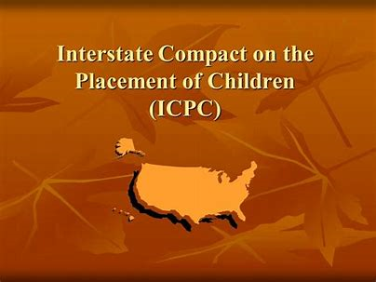
Negotiating the complexity of the ICPC

Slide 9
The Basics - adopted by all 50 states, District of Columbia, and the U.S. Virgin Islands. - Governs placement of children from one state into another. - Primary purpose to ensure caregivers/placements are safe and suitable in a uniform manner and assess who retains legal and financial responsibility for children

Slide 10
ICPC Applicability
Any Placements for Adoptions
Placements with family relatives, foster homes, or unrelated caregivers when the child is in the care or custody of a public child welfare agency
Any placements into a licensed residential treatment center
Certain placements with a parent (Non-Custodial Parent)
Notes:
Adoptions- Applies to all adoptions. Independent, private and public when placement is a necessary preliminary to the adoption. If the placement occurs for the purpose of adoption by any individual or entity (DFPS), ICPC applies.
Placements with relatives, foster homes, and unrelated caregivers completed by a court or at the request of DFPS must comply with ICPC
RTCs are same as adoptions in terms of any individual or entity.

Slide 11
Placements with Non-Custodial parent: Article III
“No sending agency shall send, bring, or cause to be sent or brought into any other party state any child for placement in foster care or as a preliminary to a possible adoption unless” there is compliance with ICPC.

Slide 12
Placements with Non-Custodial parent: Regulation No. 3
ICPC does NOT apply when:
- Court places a child with a NCP;
- Court has no evidence parent is unfit;
- Court does not seek evidence from the receiving state;
- and the court relinquishes jurisdiction immediately upon placement with NCP

Slide 13
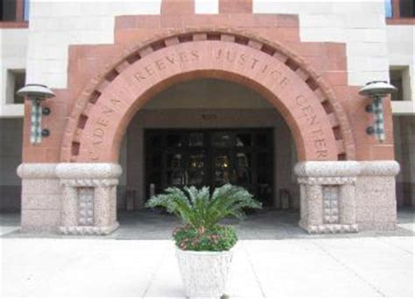
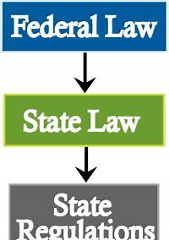
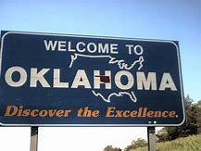
IN the Interest of C.R.-A.A, 521 S.W.3d 893
Notes:
Discuss Case.

Slide 14
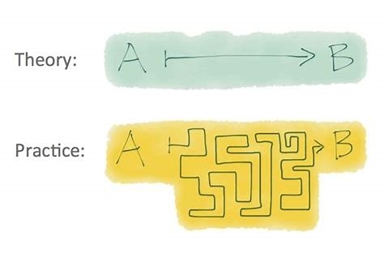
Placements with Non-Custodial parent: in practice
Notes:
REVIEW FLOW CHART

Slide 15
Indian Child Welfare Act
Kellie S. Price
DFPS Regional Attorney: Region 8
Board Certified in Child Welfare Law by the Texas Board of Legal Specialization
BIA graphic for reference only; this presentation is not sponsored by the Bureau of Indian Affairs

Slide 16
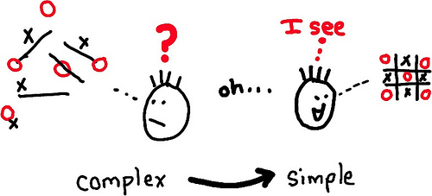
Overview
Historical Context
Notice
Active Efforts
Placement preferences
Increased burden of proof
Current litigation
Links and references
Notes:
They literally offer entire conferences on ICWA, so it was a real challenge to boil it down to 15 minutes. I’m going to focus on Notice, Active Efforts, Placement Preferences, and Expert Witness testimony as the four areas that are most likely to cause issues.

Slide 17
Historical Context
Boarding School Era:
25-35% of Native American children placed in
Foster care
Adoption placement
Institution
5x more likely to be removed from the home
Congressional Findings
No resource more vital to existence of Indian tribes than their children
Alarmingly high percentage of Indian families broken up by often unwarranted removal
25 U.S. Code § 1901
Notes:
The Department’s 2018 report on disproportionality did not inquire specifically about children who were considered Native American, American Indian, or Alaskan Native, and I was unable to find current statistics on disproportionality regarding Native American children in DFPS care. However, nationwide, Native American children are still 3-4x more likely to be removed from their families than white children.

Slide 18
Notice
In any case where the court KNOWS or has REASON TO KNOW that an Indian child is involved, party seeking termination/foster care must notify the Indian child’s tribe, the parent/Indian custodian by registered mail (RRR)
If tribe cannot be determined, notice goes to the Secretary of the Interior
At least 15 days notice, but is entitled to 20 additional days upon request
“Indian child” is unmarried under 18 and is either (a) a member of an Indian tribe or (b) is eligible for membership in an Indian tribe and is the biological child of a member of an Indian Tribe
The tribe has the right to intervene and can remove the case to tribal court, although parents can object to transfer
Tribal court has jurisdiction when child is domiciled on tribal land
Notes:
The tribe has the exclusive right to determine whether a child is a member or is eligible for membership and whether the parent is a member. Each tribe has its own requirements for membership, and not every tribe requires blood quantum. It is possible that even though a parent is not registered with a tribe, a tribe could determine that the parent or the child is a member. In my own practice, if a parent or relative indicates Native American heritage and names a specific tribe, I send out the notice, because having a denial from the tribe on file with the court is better than trying to explain why we didn’t think we had to send the notice.
From the Guidelines:
State courts must ask each participant in an emergency or voluntary or involuntary child-custody proceeding whether the participant knows or has reason to know that the child is an Indian child. The inquiry is made at the commencement of the proceeding and all responses should be on the record. State courts must instruct the parties to inform the court if they subsequently receive information that provides reason to know the child is an Indian child.
(b) If there is reason to know the child is an Indian child, but the court does not have sufficient evidence to determine that the child is or is not an “Indian child,” the court must:
(1) Confirm, by way of a report, declaration, or testimony included in the record that the agency or other party used due diligence to identify and work with all of the Tribes of which there is reason to know the child may be a member (or eligible for membership), to verify whether the child is in fact a member (or a biological parent is a member and the child is eligible for membership); and
(2) Treat the child as an Indian child, unless and until it is determined on the record that the child does not meet the definition of an “Indian child” in this part.
(c) A court, upon conducting the inquiry required in paragraph (a) of this section, has reason to know that a child involved in an emergency or child-custody proceeding is an Indian child if:
(1) Any participant in the proceeding, officer of the court involved in the proceeding, Indian Tribe, Indian organization, or agency informs the court that the child is an Indian child;
(2) Any participant in the proceeding, officer of the court involved in the proceeding, Indian Tribe, Indian organization, or agency informs the court that it has discovered information indicating that the child is an Indian child;
(3) The child who is the subject of the proceeding gives the court reason to know he or she is an Indian child;
(4) The court is informed that the domicile or residence of the child, the child’s parent, or the child’s Indian custodian is on a reservation or in an Alaska Native village;
(5) The court is informed that the child is or has been a ward of a Tribal court; or
(6) The court is informed that either parent or the child possesses an identification card indicating membership in an Indian Tribe.
Right to intervene exists at ANY POINT.

Slide 19
Active Efforts
Any party seeking a foster care placement of termination of parental rights regarding an Indian child shall satisfy the court that active efforts have been made to provide services to prevent the breakup of the Indian family
Active efforts are affirmative, active, thorough and timely efforts to maintain or reunite an Indian child with his or her family
Not exhaustive list; think best practices; cases still decided case by case basis
Choctaw Nation active efforts checklist good reference, attached with materials or can be shared with caseworkers by request
Notes:
1) Conducting a comprehensive assessment of the circumstances of the Indian child's
family, with a focus on safe reunification as the most desirable goal;
(2) Identifying appropriate services and helping the parents to overcome barriers,
including actively assisting the parents in obtaining such services;
(3) Identifying, notifying, and inviting representatives of the Indian child's Tribe to
participate in providing support and services to the Indian child's family and in family
team meetings, permanency planning, and resolution of placement issues;
(4) Conducting or causing to be conducted a diligent search for the Indian child's
extended family members, and contacting and consulting with extended family members
to provide family structure and support for the Indian child and the Indian child's
parents;
(5) Offering and employing all available and culturally appropriate family preservation
strategies and facilitating the use of remedial and rehabilitative services provided by the
child's Tribe
(6) Taking steps to keep siblings together whenever possible;
(7) Supporting regular visits with parents or Indian custodians in the most natural
setting possible as well as trial home visits of the Indian child during any period of
removal, consistent with the need to ensure the health, safety, and welfare of the
child;
(8) Identifying community resources including housing, financial, transportation,
mental health, substance abuse, and peer support services and actively assisting
the Indian child's parents or, when appropriate, the child's family, in utilizing and
accessing those resources;
(9) Monitoring progress and participation in services;
(10) Considering alternative ways to address the needs of the Indian child's parents
and, where appropriate, the family, if the optimum services do not exist or are not
available;
(11) Providing post reunification services and monitoring

Slide 20
Placement Preferences
In the absence of good cause to the contrary preference shall be given to a placement with:
A member of the Indian child’s extended family
This definition is broader than Texas’s requirement for notice to family members within the 3rd degree
A foster home licensed, approved or specified by the child’s tribe
An Indian foster home licensed or approved by an authorized non-Indian licensing authority
An institution for children approved by an Indian tribe or operated by an Indian organization which has a program suitable to meet the Indian child’s needs
Efforts to comply with preferences must be documented
Notes:
Extended family member is defined by the law or custom of the Indian child’s Tribe or, in the absence of such law or custom, is a person who has reached age 18 and who is the Indian child’s grandparent, aunt or uncle, brother or sister, brother-in-law or sister-in-law, niece or nephew, first or second cousin, or stepparent
Working with the tribe is important. In some cases, if the Tribe is looking to place the child on the reservation, ICPC may not be necessary because tribes are sovereign and often not signatories to ICPC.
Must document efforts to comply with the placement preferences.

Slide 21
Increased Burden of Proof
At Removal
At Termination of Parental Rights
Clear and convincing evidence
Supported by qualified expert testimony
Continued custody of the child by the parent or Indian custodian is likely to result in serious emotional or physical damage to the child
Beyond a reasonable doubt
Supported by qualified expert testimony
Continued custody of the child by the parent or Indian custodian is likely to result in serious emotional or physical damage to the child
Notes:
Remember that relinquishments require a special procedure, where the relinquishment is explained on the record in court, so they cannot be done in mediation or outside of court.
Support by the qualified expert is required regardless of whether the tribe has chosen to intervene.
§ 23.122 Who may serve as a qualified expert witness?
(a) A qualified expert witness must be qualified to testify regarding whether the child’s continued custody by the parent or Indian custodian is likely to result in serious emotional or physical damage to the child and should be qualified to testify as to the prevailing social and cultural standards of the Indian child’s Tribe. A person may be designated by the Indian child’s Tribe as being qualified to testify to the prevailing social and cultural standards of the Indian child’s Tribe.
(b) The court or any party may request the assistance of the Indian child’s Tribe or the BIA office serving the Indian child’s Tribe in locating persons qualified to serve as expert witnesses.
(c) The social worker regularly assigned to the Indian child may not serve as a qualified expert witness in child-custody proceedings concerning the child.
The rule does not, however, strictly limit who may serve as a qualified expert witness to only those individuals who have particular Tribal social and cultural knowledge. The rule recognizes that there may be certain circumstances where a qualified expert witness need not have specific knowledge of the prevailing social and cultural standards of the Indian child’s Tribe in order to meet the statutory standard. For example, a leading expert on issues regarding sexual abuse of children may not need to know about specific Tribal social and cultural standards in order to testify as a qualified expert witness regarding whether return of a child to a parent who has a history of sexually abusing the child is likely to result in serious emotional or physical damage to the child. Thus, while a qualified expert witness should normally be required to have knowledge of Tribal social and cultural standards, that may not be necessary if such knowledge is plainly irrelevant to the particular circumstances at issue in the proceeding.
Separate expert witnesses may be used to testify regarding potential emotional or physical damage to the child and the prevailing social and cultural standards of the Tribe.
A person testifying to the prevailing social and cultural standards of the Indian child’s Tribe must be knowledgeable and experienced in the Tribe’s society and culture. The Indian child’s Tribe may designate a person as being qualified to testify to the prevailing social and cultural standards of the Indian child’s Tribe.

Slide 22
Current litigation Brackeen v. Zinke
U.S. Dist. Ct. Northern Dist ruled:
ICWA and Final Rule unconstitutional
5th amendment equal protection—raced based placement preferences
Art. 1– commandeering state power over domestic relations
Commerce Clause—exceeding Congress’ authority to enact the law
On appeal to the 5th Circuit Court of Appeals
5th Circuit granted stay (i.e. ICWA still needs to be followed)
Oral arguments were on March 13
Will be appealed to U.S. Supreme Court

Slide 23
Links and References
ICWA: http://uscode.house.gov/view.xhtml?req=granuleid%3AUSC-prelim-title25-chapter21&edition=prelim
Final Rule: https://www.bia.gov/sites/bia.gov/files/assets/bia/ois/pdf/idc1-034238.pdf
25 CFR part 23
ICWA Guidelines: https://www.bia.gov/sites/bia.gov/files/assets/bia/ois/pdf/idc2-056831.pdf
Brackeen v. Zinke https://www.dfps.state.tx.us/Child_Protection/Attorneys_Guide/documents/Section_4_ICWA/Brackeen_v_Zinke.pdf

Slide 24
Special Immigrant juvenile status
Lucinda Garcia Valdez
DFPS Regional Attorney, Region 8
lucinda.valdez@dfps.state.tx.us
210-213-7168

Slide 25
What is special immigrant juvenile status?
Permits eligible foster children to “self-petition” for a visa.
Provides the child with the ability to "adjust status," or obtain permanent resident status without returning to their home country for an interview at the U.S. consulate.

Slide 26
Step one: SIJS Order by state family court
Motion for Findings Regarding Special Immigrant Juvenile Status, accompanied with a Supporting Affidavit prepared by the case worker, must be filed before a family court.
Order on Motion to Determine Eligibility for Special Immigrant Juvenile Status: Court must make three specific findings.
3) The family court order DOES NOT confer any immigration status. The order is a prerequisite to SIJS relief through USCIS.

Slide 27
Court findings
Dependent/Custody
The court must find that "the child has been declared a dependent of the court or has been placed by the court under the custody of a state agency or an individual or entity appointed by the court."

Slide 28
2) Reunification
The court must also find that "reunification of the child with one or both parents is not viable as a result of abuse, neglect or abandonment (or a similar basis found under state law).“
3) Best Interest
The court must find that it is not in the child's best interest to be returned to the child's country of origin or last habitual residence.

Slide 29
Important factors to consider
AGE:
On the date the petition (I-360)was filed, the child was under 21 and unmarried.
b. ADOPTION:
a. If a child obtains permanent resident status before being adopted, the child may qualify for automatic citizenship if the adoption is consummated before the child is 16 years old. Otherwise, the child would have to adjust in their country of origin.

Slide 30
CHILDREN WITH DISABILITIES
Obtaining permanent resident status is particularly crucial for children with severe disabilities who may need Supplemental Security Income (SSI). Very few permanent residents can qualify for SSI and as a result, most youth must become U.S. citizens to qualify. Although a youth cannot generally apply to become a naturalized citizen until age 18, eligibility also requires at least five years as a permanent resident.
d. ROADBLOCKS TO APPROVAL
Juvenile History, Mental Health, Drug use, Prior Deportation Orders and delinquent behavior on behalf of the child could affect the child’s ability to be approved for permanent legal resident status. All of this has to be considered prior to initiating the process

Slide 31
Step two: uscis process
Once the family court signs the SIJS order, the next step is completing the forms and compiling the required supporting documents for both the SIJS petition (I-360) and application for adjustment of status (I-485) if priority date is current.
If priority date is NOT current, application for adjustment of status will be completed and sent into USCIS once current.

Slide 32
VISA BULLETIN FOR APRIL 2019
Employment- based | All Chargeability Areas Except Those Listed | CHINA- mainland born | EL SALVADOR GUATEMALA HONDURAS | INDIA | MEXICO | PHILIPPINES | VIETNAM
1st | 01FEB18 | 22FEB17 | 01FEB18 | 22FEB17 | 01FEB18 | 01FEB18 | 01FEB18
2nd | C | 01APR16 | C | 12APR09 | C | C | C
3rd | C | 01AUG15 | C | 22JUN09 | C | 01MAR18 | C
Other Workers | C | 22AUG07 | C | 22JUN09 | C | 01MAR18 | C
4th | C | C | 08MAR16 | C | 01APR18 | C | C
Certain Religious Workers | C | C | 08MAR16 | C | 01APR18 | C | C
5th Non-Regional Center (C5 and T5) | C | 15SEP14 | C | C | C | C | 22AUG16
5th Regional Center (I5 and R5) | C | 15SEP14 | C | C | C | C | 22AUG16

Slide 33
After the complete packet is submitted, USCIS will send an appointment notice for the biometric fingerprints for any child age 14 or above.
Once the fingerprints are taken and the criminal background check is completed, the last step in the process is an interview at the district USCIS office.
Interview can be waived if child under age 14 or when the adjudicating officer deems it necessary. If an interview is held, a letter approving permanent resident status is often generated at the interview and the actual permanent resident card ("green card") is mailed later.
Request for Evidence (RFE) can be issued if USCIS needs more information.
If SIJS is denied, an appeal can be filed with the Board of Immigration Appeals.

