Slide 1
Alternative Response: An Introduction
StakeHolder Webinar
March 23, 2017

Slide 2
Goals
Provide an overview of Texas’ Alternative Response model
Explore history, values and assumptions
Review screening and eligibility criteria
Discuss implementation plan
Answer your questions and provide you with resources

Slide 3
Words of Wisdom
~Dr. Bruce Perry, M.D., Ph. D
“A lot of times the [family] situation calls for the formation of a healing relationship so the very act of going there in an investigatory mode impairs the ability [for workers] to form a meaningful relationship in which parents can be open, ask for and get help”
~ Dr. Bruce Perry, M.D., PH.D
Senior Fellow
Child Trauma Academy
www.childtrauma.org
. D
Senior Fellow
Child
Child Trauma Academy

Slide 4
Differential Response National
Alternative Response
Texas

Slide 5
Alternative Response is . . .
An approach that allows child protective services to respond differently to accepted reports of child abuse and neglect based on such factors as the type and severity of the alleged maltreatment, number and sources of previous reports, and willingness of the family to participate in services. (American Humane Association)

Slide 6
Benefits of Alternative Response
Child Safety is not compromised
Collaborative nature is more “family friendly” and improves community relations through partnerships
Reduction in the number of families re-reported to CPS system
Increased family and caseworker satisfaction

Slide 7
Principles of Alternative Response
Alternative to traditional child protection investigative response
Sets aside fault finding and substantiation decision
Only some P2 reports are eligible
Focuses less on proving whether the allegation is true or not
Seeks safety through family engagement and collaborative partnerships
Allows and encourages CPS to provide services to address safety concerns at the front end of the system

Slide 8
What Alternative Response is NOT
A model used for all families
A replacement for traditional investigations
A process that will change the number or type of cases CPS receives at the front door or to which CPS responds
A response appropriate for all reports of abuse and neglect

Slide 9
Practice Framework and Assumptions
The primary goal of any CPS response (AR or TR) is child safety
Most families want to address threats to child safety & can be partners in achieving child safety
Circumstances and needs of families differ, so should our response
Families are more than the presenting concerns
Protective factors can assist in keeping children safe
Families are helped through connections with community services and resources

Slide 10
New program
CPS “Lite”
Children are unsafe
Lower caseloads
Easier cases
Access to more resources
Hard issues aren’t addressed with families
Completely family driven
All work is done after 5:00 pm
M
Y
T
H
S

Slide 11
How does this work help families?
It creates a renewed perspective on respect for families
AR supports caseworkers in slowing down and learning to be more patient when working with families
AR helps us, as those working with families, to recognize families are more than the presenting problem/concern
The assessment process gives us a much richer understanding of the dynamics of the family.

Slide 12
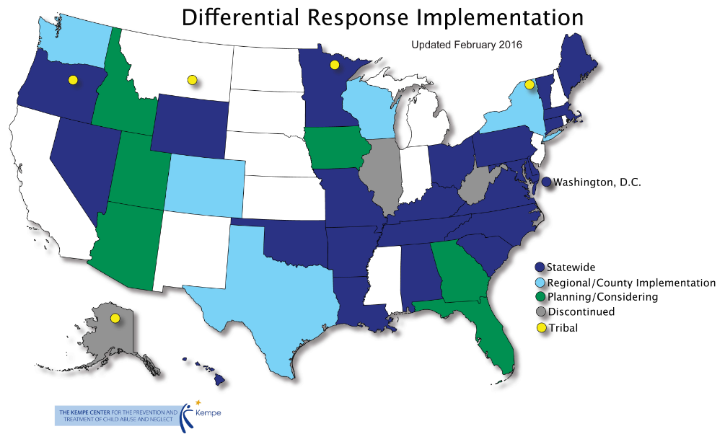
As of February 2016

Slide 13
THE TEXAS ALTERNATIVE RESPONSE MODEL

Slide 14
Why Implement Alternative Response in Texas?
Majority of reports Texas receives do not need a forensic approach or court-ordered interventions
Labeling a person as a perpetrator does little to increase child safety
Entry into the central registry has significant negative impacts on individuals
Improved family/caseworker satisfaction

Slide 15
And Most Importantly . . .
We realize that the best way to prevent child abuse is to help parents develop the skills and identify the resources they need to understand and meet their children's needs and protect them from harm (Child Welfare Information Gateway, 2013)

Slide 16
Legal Background
SB 423 (83rd Regular Session)
Amended TFC 261.3015 to authorize DFPS to conduct an Alternative Response to an investigation that otherwise meets the criteria for a CPS investigation.

Slide 17
State
Screeners
Traditional Response (Investigation)
Alternative Response (15%)
CVS
FBSS
Case Closure
Case Closure

Slide 18
Texas’ Core Elements
AR is a new Stage of Service
Target: screened in cases
Clear criteria for assigning to AR/TR
Pathway assignment can be changed
If assigned to AR, family can choose TR
Safety is primary concern
There is no entry onto the central registry
No findings/validation decision for AR cases
Notes:
.

Slide 19
What kinds of reports will be in AR in Texas?

Slide 20
What is eligible?
Cases eligible for formal screening by the screeners.
Intakes with children younger than age 6 when those children are not designated as victim children.
Intakes involving PHAB when all children in the home are age 6 or older.

Slide 21
What is not eligible?
Priority 1 Cases
High risk Priority 2 cases
Fatality cases, sexual abuse cases, school investigations, manufacturing drugs and other high risk cases.

Slide 22
Working the Case
24 hours to attempt scheduling contact
5 days for first face to face contact
24 hours to complete Safety and Family Needs Assessment (from first face-to-face with family)
Face to face contact every 30 days (required), contact every 7 days
Case submitted within 60 days

Slide 23
CPS Responses
ALL CPS Cases
Child Safety is Paramount
Assess for safety and Risk
Assess the family’s strengths and needs
Offer services as needed
Complete a Safety Assessment and interview all children in the home
Gather additional information about the safety of the children
May include notifying and partnering with Law Enforcement
Investigations
*Serious Abuse/Neglect, P1s and a subset of P2s
24 or 72 hours to complete FTF contact with alleged victims
Parents are typically notified after interviewing children
A disposition is assigned
An AP is identified
Alternative Response
*Screened in Low – Moderate Abuse/Neglect cases (at intake)
5 days to complete a FTF family assessment
Parents are contacted before interviewing children
Families can choose AR or INV
No disposition is made
No AP is identified

Slide 24
Alternative Response and Casework Practice
Solution-Focused Practice
Family as expert
Not knowing stance
Baby steps
Flexibility in how we respond to each family
Focus on securing child safety by understanding child vulnerability, safety threats, and protective actions
Recognizing and applying family and community strengths and resources

Slide 25
Engagement Strategies
Communicate with families strategically
Avoid drop in visits
Ask parental permission to see
children
Be transparent in purpose
and process
Honor family decisions
unless they compromise
safety

Slide 26
This is Already Happening!

Slide 27
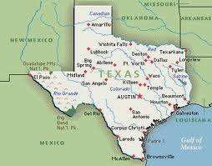
IMPLEMENTATION SCHEDULE
Initial Roll out Sites
Statewide Implementation

Slide 28
Texas Alternative Response Model: Where…
Initial implementation …
Region 1 (November 2014):
Potter and Randall Counties (Amarillo) – Urban area
Hansford, Hutchinson, Carson, Ochiltree, Roberts, Gray, Donley, Lipscomb, Hemphill, Wheeler, Collingsworth, Childress, Hall and Armstrong - Rural area
Region 11: (December 2014)
Webb County (Laredo) – Urban and rural
Region 3: (January 2015)
Dallas County (Dallas) – Urban area
Hunt, Rockwall, Kaufman and Navarro - Rural area

Slide 29
Texas Alternative Response Model: When…
Full implementation …
Region 1 (May 4, 2015):
Region 11: (July 13, 2015)
Region 3: (November 2, 2015)
Region 7: (February 1, 2016)
Region 9: (May 2, 2016)
Region 4/5: (April 3, 2017)

Slide 30
Research – National and Local
General Research
Texas Evaluation

Slide 31
What Does the Research Say?
Child safety not diminished
Family engagement under AR
CPS staff reacted positively
Services to families and children increased and changed
New reports and later placements of children reduced
Short-term costs greater, long-term costs reduced
Institute of Applied Research
MO, 2000
Randomized Control Trials
MN, 2004
MN Follow-Up, 2006
OH, 2010
OH Follow-Up, 2014
CO, 2014
IL, 2014

Slide 32
Table 1 Over 30,000 AR Cases Opened in the 5 Initial Regions From November 2014 thru February 2017

Slide 33
Table 2 Less Than 10% of the Cases Stage Progress

Slide 34
Table 3 Only a Few % Stage Progress to CVS or FBSS

Slide 35
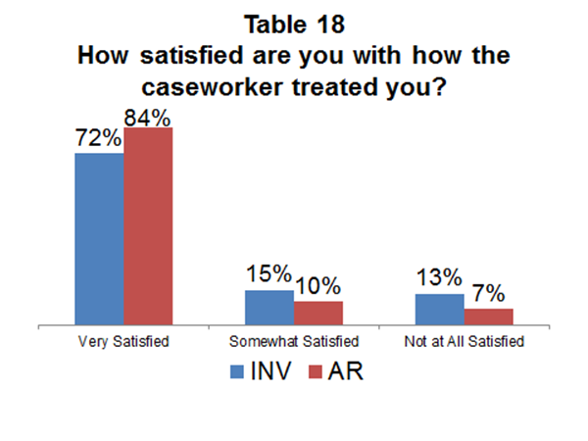

Slide 36
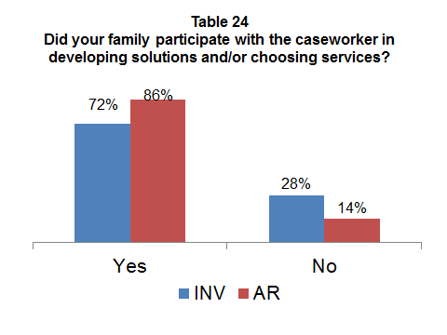

Slide 37
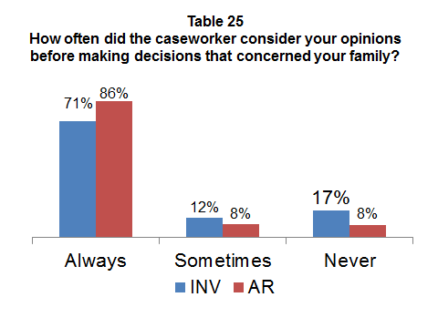

Slide 38
Resources
Texas DFPS Website
http://intranet.dfps.txnet.state.tx.us/CPS/AR/default.asp
The Kempe Center
www.thekempecenter.org
Quality Improvement Center on Differential Response
www.DifferentialResponseQIC.org

Slide 39
QUESTIONS

